Slide 1
Lecture No. 8 Fuel Cells
At the end of this lecture, students will be able to:
Explain the working principle of fuel cells
Describe the construction of Hydrogen-Oxygen and Methanol-Oxygen fuel cells
Discuss the applications of fuel cells

Slide 2
Fuel Cells
Fuel cell is a galvanic cell in which the chemical energy of a fuel oxidant system is converted directly into electrical energy by means of electrochemical process
OR
Fuel cells are the galvanic cells in which chemical energy of fuel is directly converted into electrical energy
Unlike a battery, chemicals are not stored in the fuel cell; they must be replenished
Possible fuel sources: hydrogen, alcohols, hydrocarbons, gasoline
Possible oxidants: oxygen, chlorine, chlorine dioxide
Similar to refueling of an internal combustion engine, efficient and quiet like a battery

Slide 3
Fuel Cells
Differences between a fuel cell and a battery
Battery | Fuel Cell
A battery stores the chemical reactants, usually metal compounds like lithium, zinc or manganese | A fuel cell actually generates electricity through reactants (Ex: hydrogen and oxygen) supplied from outside
Once used up, battery must be recharged or thrown away | The fuel cell will produce electricity as long as it has a fuel supply. In short, a fuel cell vehicle is refueled instead of recharged
Batteries are less eco friendly | Fuel cells are more eco friendly
Power output is low | Power output is high

Slide 4

Fuel Cells
H₂-O₂ Fuel-cell characteristics

Slide 5

Fuel Cells
Types:
Polymer Electrolyte Membrane (PEM) Fuel Cells
Direct Methanol Fuel Cells
Alkaline Fuel Cells
Phosphoric Acid Fuel Cells
Molten Carbonate Fuel Cells
Solid Oxide Fuel Cells
Regenerative Fuel Cells

Slide 6
H₂-O₂ Fuel-cell characteristics
Anode (-) and Cathode (+) on each side of the fuel cell, separated by an electrolyte (KOH or NaOH)
Hydrogen gas is channeled through anode side
Oxygen passes through cathode
Platinum catalyst oxidizes hydrogen atoms into H⁺ and electrons
Electrons pass along external circuit; conduct electricity before entering cathode
Electrolyte allows H⁺ to pass into the cathode
In cathode, catalyst combines H⁺ , O²⁻ and electrons, forming H₂O and heat

Slide 7
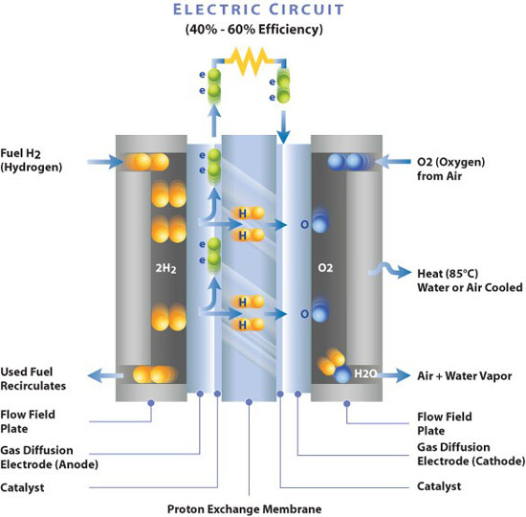
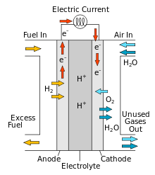
H₂-O₂ Fuel-cell characteristics
It consists of two electrodes made of porous graphite impregnated with an catalyst such as Pt or Ni or Cd at Anode and CoO at and separated by Polystyrene sulphonic acid ion exchange membrane in KOH or NaOH (Electrolyte)

Slide 8
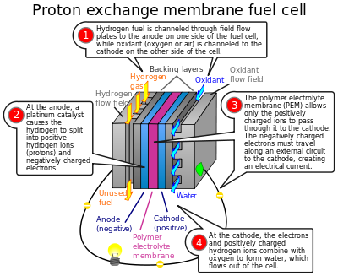

Slide 9
H₂-O₂ Fuel-cell characteristics
Anodic and cathodic compartments are present
Electrodes are made up of graphite impregnated with Pt-Ru-Co
Hydrogen is bubbled through the anodic compartment
Oxygen is bubbled through the cathodic compartment
Electrolyte is concentrated KOH solution
C, Pt / H₂ / KOH / O₂ / Pt, C
Water is formed as the product, which dilutes the KOH, and hence the electrolyte is kept hot (400K) and also the cell is provided with a wick, which helps in maintaining the water balance
Notes:
If water is evaporated too quickly, the membrane dries, resistance across it increases, and eventually it will crack, creating a gas "short circuit" where hydrogen and oxygen combine directly, generating heat that will damage the fuel cell

Slide 10
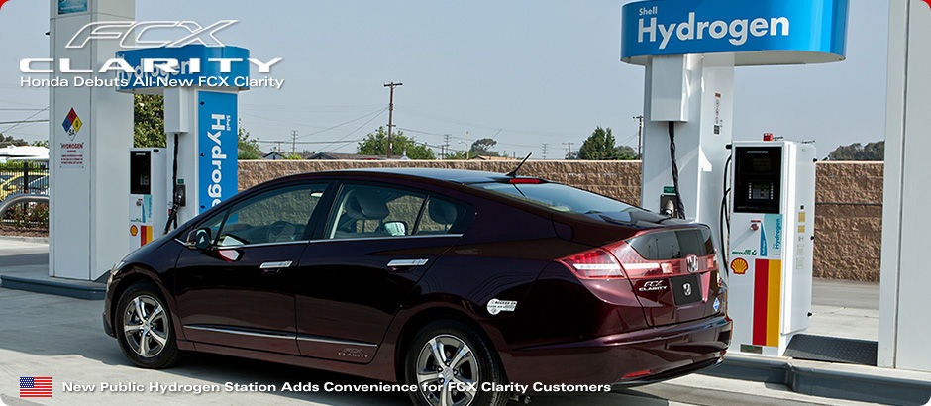

H₂-O₂ Fuel-cell characteristics
At anode H₂ + 2OH⁻ ⇌ 2H₂O + 2e
At cathode ½ O₂ + H₂O + 2e ⇌ 2OH⁻
Net reaction H₂ + ½ O₂ ⇌ H₂O
Note: This is exact opposite of electrolysis
Honda FCX Clarity, USA
Price: Approx. USD 50,000
Toyota Mirai, Japan
Price: More than USD 1 Lakh

Slide 11


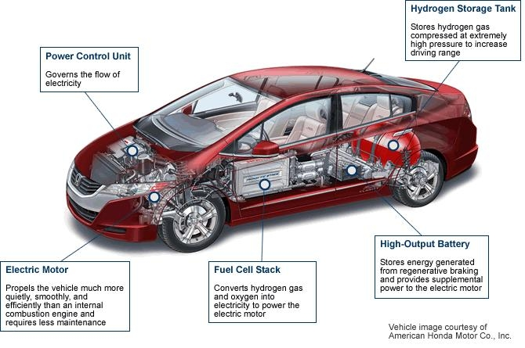
H₂-O₂ Fuel-cell characteristics
Applications:
Fuel cells are very useful as power sources in remote locations, such as spacecraft, remote weather stations, large parks, rural locations, and in certain military applications
Fuel cell powered bicycle, China

Slide 12
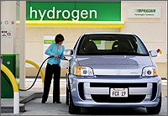
H₂-O₂ Fuel-cell characteristics
Advantages:
Hydrogen energy is very efficient fuel source than traditional sources of energy and produces more energy per pound of fuel
Hydrogen is available in plenty
Hydrogen is non-toxic and eco-friendly
Theoretically 80% efficient
Disadvantages:
Gases should be of super clean and cheap (which is not)
Sensitive to CO₂

Slide 13
H₂-O₂ Fuel-cell characteristics
Fuel cells are generally between 40–60% energy efficient (maximum theoretical energy efficiency of a fuel cell is 83%)
A gas turbine would capture heat from the fuel cell and turn it into mechanical energy to increase the fuel cell's operational efficiency
Tank-to-wheel efficiency of a fuel-cell vehicle is greater than 45% at low loads and shows average values of about 36% when a driving cycle like the NEDC (New European Driving Cycle) is used as test procedure (The comparable NEDC value for a Diesel vehicle is 22%)
In 2008 Honda released a demonstration fuel cell electric vehicle (the Honda FCX Clarity) with fuel stack claiming a 60% tank-to-wheel efficiency
Notes:
fuel cells are generally between 40–60% energy efficient. This is higher than some other systems for energy generation. For example, the typical internal combustion engine of a car is about 25% energy efficient.

Slide 14
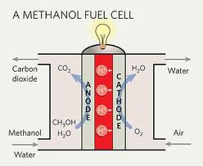
Methanol - Oxygen fuel cell

Slide 15
Methanol - Oxygen fuel cell
Consists of anodic and cathodic compartments
Electrodes are made up of platinum impregnated with ruthenium or gold, which can effectively oxidize carbon monoxide formed during redox reaction
Methanol containing H₂SO₄ is passed through anodic compartment
Oxygen is passed through cathodic compartment
Electrolyte consists of sulphuric acid
A membrane is provided which prevents the diffusion of methanol into the cathode which otherwise get oxidized
Here acid catalyst is used, so that carbon dioxide can be easily removed
C, Pt /CH₃OH / H₂SO₄ / O₂ / Pt, C

Slide 16
Methanol - Oxygen fuel cell
Reactions:
At anode: CH₃OH + H₂O → CO₂ + 6H⁺ + 6e
At cathode: 3/2 O₂ + 6H⁺ + 6e → 3 H₂O
Net cell reaction: CH₃OH + 3/2 O₂ → 2 H₂O + CO₂
Characteristics:
Energy density (15 times higher than Lithium-ion batteries) and power density are high, Energy efficiency is low
Sensitive to CO₂ – if alkali is used this leads to the formation of carbonates spoiling the quality of electrodes, hence sulphuric acid is used
Methanol is toxic and flammable

Slide 17
Applications
Ideal for smaller vehicles such as forklifts and tuggers
Military applications include power for soldier-carried tactical equipment, battery chargers, and autonomous power for test and training instrumentation
Currently available with power outputs between 25 watts and 5 kilowatts with durations up to 100 hours between refueling
Advantages: Eco-friendly, ease of transport of methanol, an energy-dense yet reasonably stable liquid at all environmental conditions
Disadvantages: Same temperature must be maintained throughout the cell to avoid thermal loading, limited CO₂ tolerance by some cathode materials [non-poly(3,4-ethylene dioxy thiophene]

Slide 18
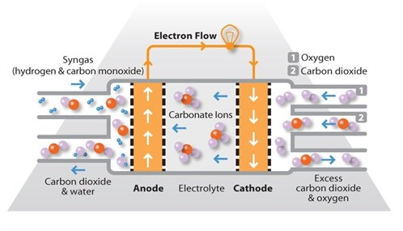
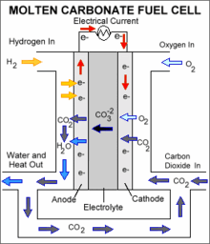

Molten Carbonate fuel cell
Notes:
Notter, Dominic A.; Kouravelou, Katerina; Karachalios, Theodoros; Daletou, Maria K.; Haberland, Nara Tudela (2015). "Life cycle assessment of PEM FC applications: electric mobility and μ-CHP". Energy Environ. Sci. 8 (7): 1969–1985. doi:10.1039/C5EE01082A.

Slide 19
Molten Carbonate fuel cell
MCFCs are high-temperature fuel cells that use an electrolyte composed of a molten carbonate salt mixture suspended in a porous, chemically inert ceramic matrix of beta-alumina solid electrolyte (BASE)
Salts commonly used include lithium carbonate, potassium carbonate and sodium carbonate
Operate at extremely high temperatures of 650 °C

Slide 20
Molten Carbonate fuel cell
High operating temperature dramatically improves reaction kinetics and thus it is not necessary to boost these with a noble metal catalyst
Cell is less prone to carbon monoxide poisoning than lower temperature systems
MCFC systems can operate on a variety of different fuels, including coal-derived fuel gas, methane or natural gas, eliminating the need for external reformers
Disadvantages associated with MCFC units arise from using a liquid electrolyte rather than a solid
Required to inject carbon dioxide at the cathode as carbonate ions are consumed in reactions occurring at the anode

Slide 21
Molten Carbonate fuel cell - Applications
MCFCs are used in large stationary power generation
Most fuel cell power plants of megawatt capacity use MCFCs, as do large combined heat and power (CHP) and combined cooling and power (CCP) plants
MCFCs can work at up to 60% efficiency for fuel to electricity conversion, and overall efficiencies can be over 80% in CHP or CCP applications where the process heat is also utilized

Slide 22
Summary
Construction and working principle of
H₂-O₂ fuel cell: H₂ + ½ O₂ ⇌ H₂O
Methanol-Oxygen fuel cell: CH₃OH + 3/2 O₂ → 2 H₂O + CO₂
Molten carbonate fuel cell: The reaction remains the same as that of H₂-O₂ fuel cell, however the electrolyte used will be molten carbonate comprising of salts like lithium carbonate, potassium carbonate and sodium carbonate

